Slide 1
Wastewater Overflows Evidence: Graphs and Maps

Slide 2
Evidence Briefs
David Wilson – Overview and Governance
Neville West – Overview of Wastewater Network, Issues and Responses
Wolfgang Kanz – DrainWise Programme and Consultation with Tangata Whenua
Ian Garside – Wastewater Network Modelling
Bridget Bosworth – Analysis of Rainfall and Overflow Events
Dr Brett Beamsley – Hydrodynamic Modelling
Dr Shane Kelly - Ecology
Dr Peter Wilson – Water Quality
Dr Michael Stewart – Ecology (Emerging Organic Contaminants)
Dr Christopher Dada – Quantitative Microbial Risk Assessment
Ian Mayhew – Planning

Slide 3
DAVID WILSON

Slide 4
Chief Executive
Community Lifelines
Environmental Services and Protection
Transformation and Relationships
Liveable Communities
Internal Partnerships
Finance
Water, wastewater and stormwater

Slide 5
NEVILLE WEST

Slide 6
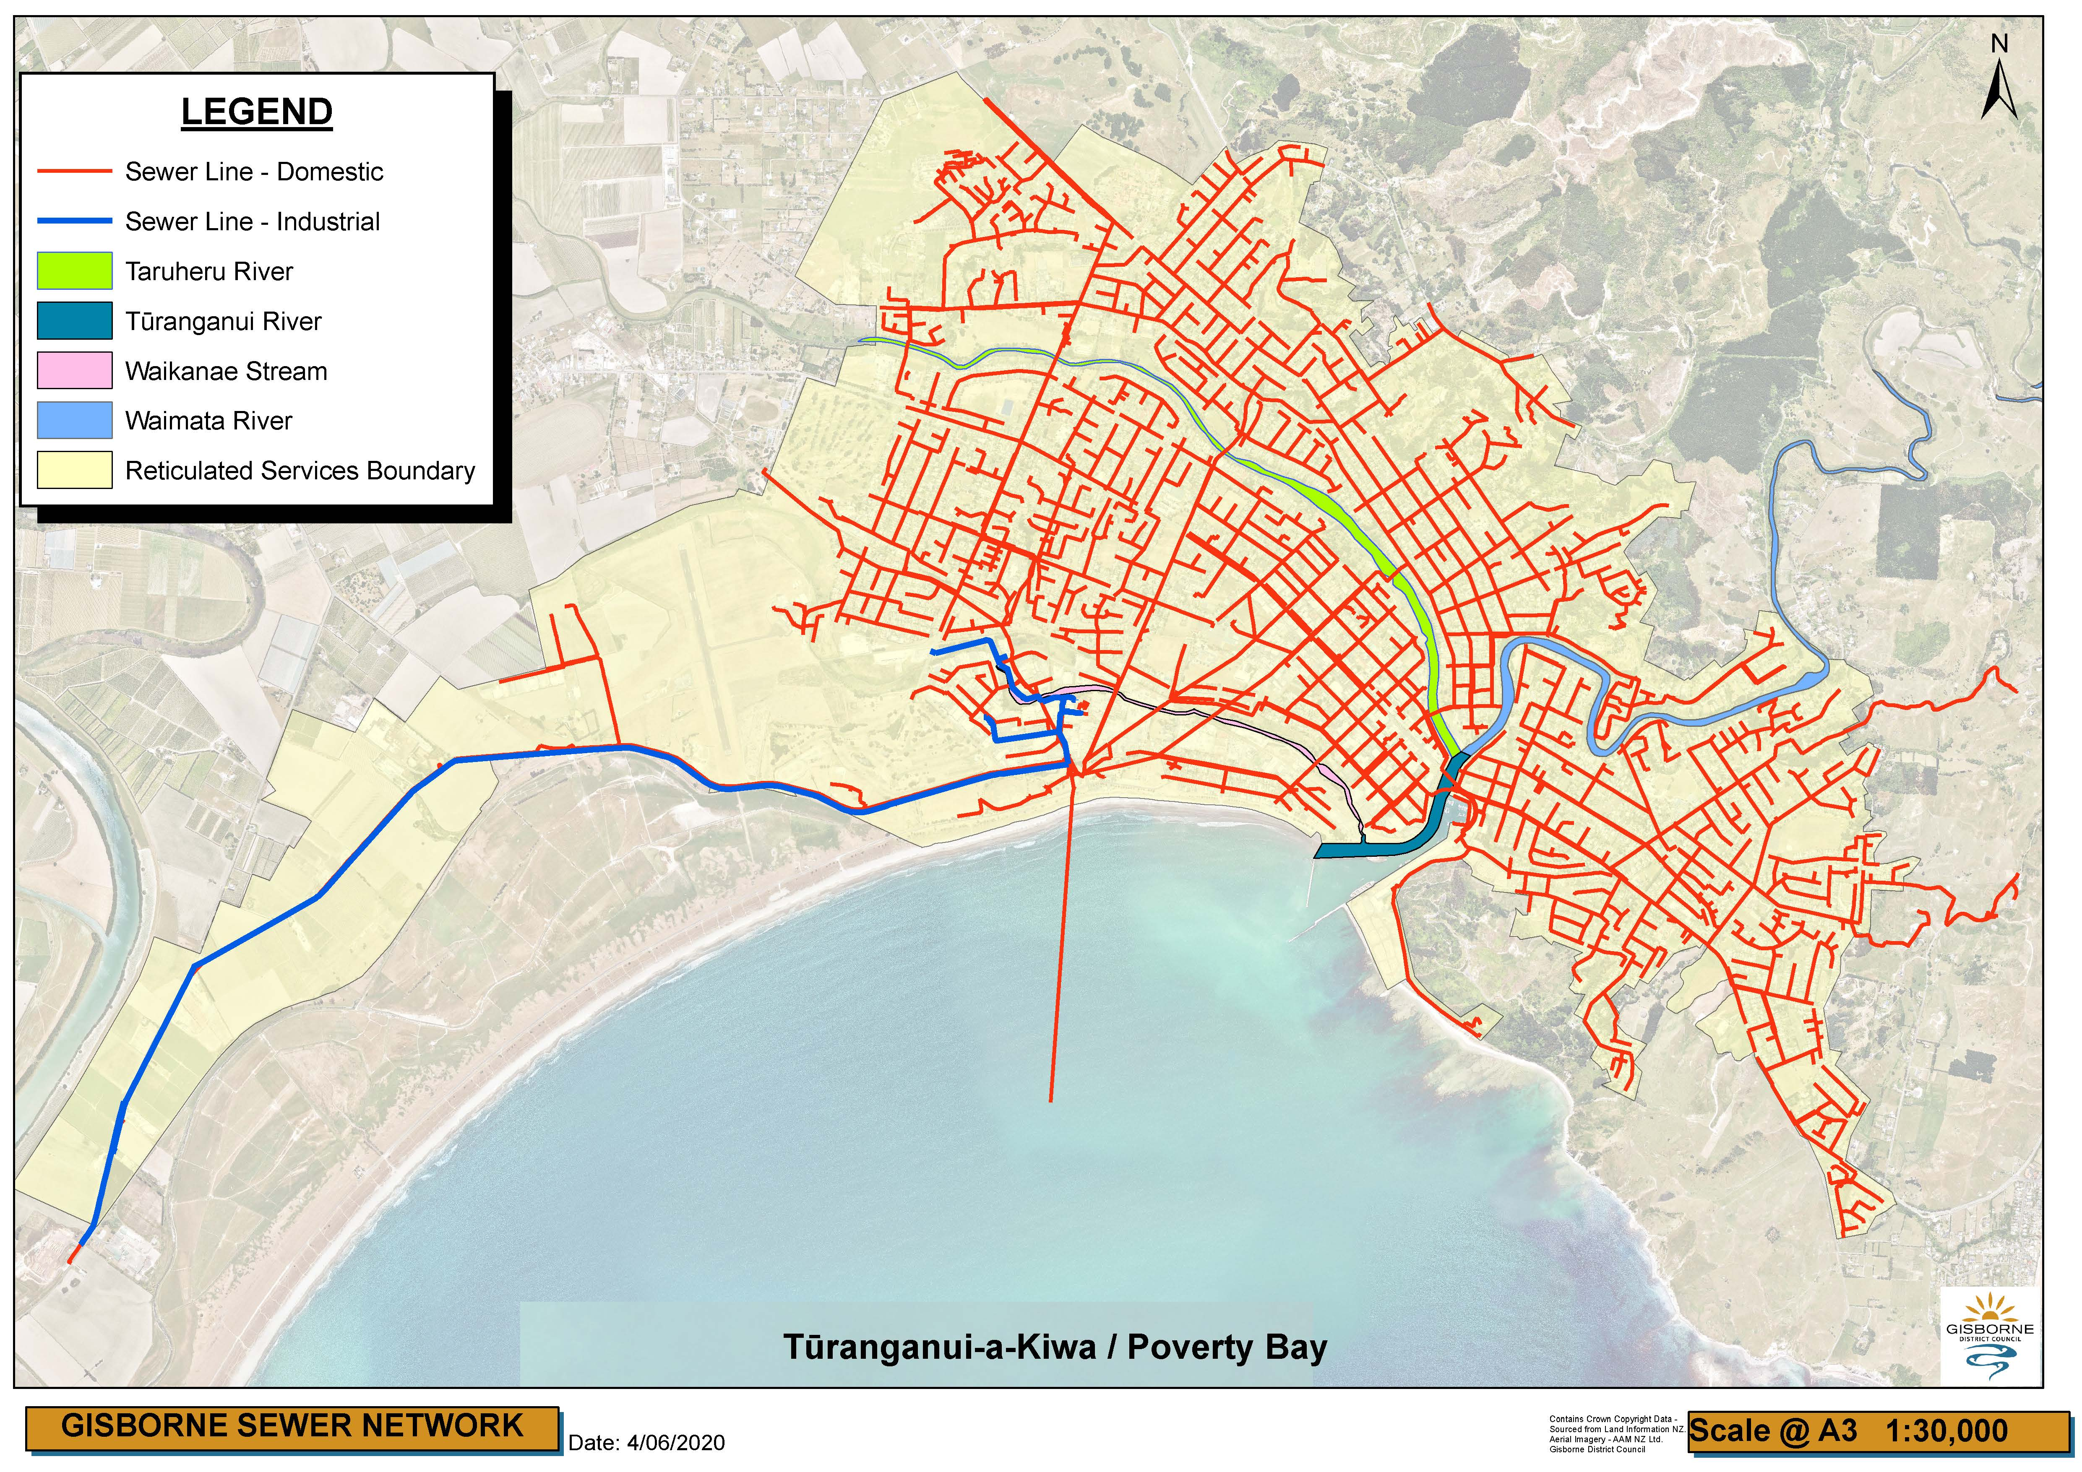

Slide 7
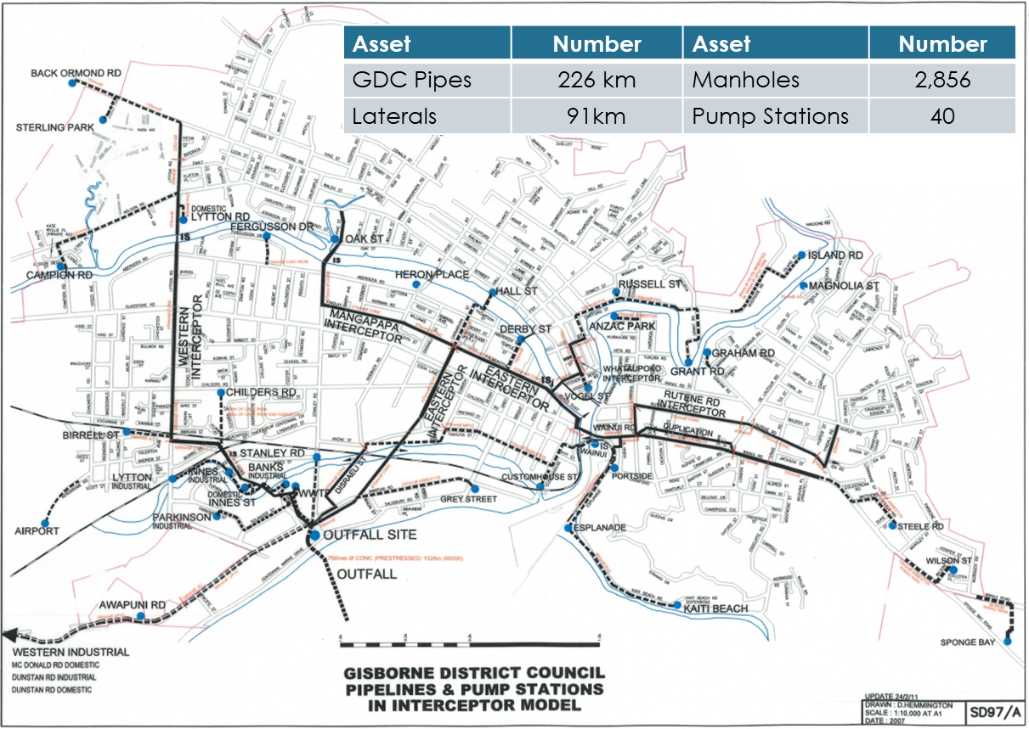

Slide 8
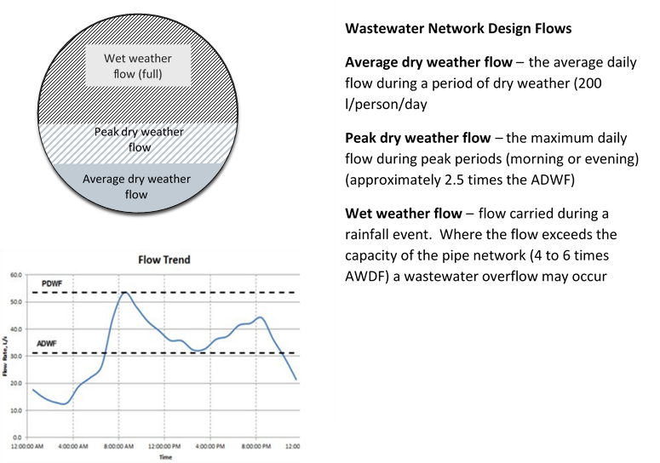

Slide 9
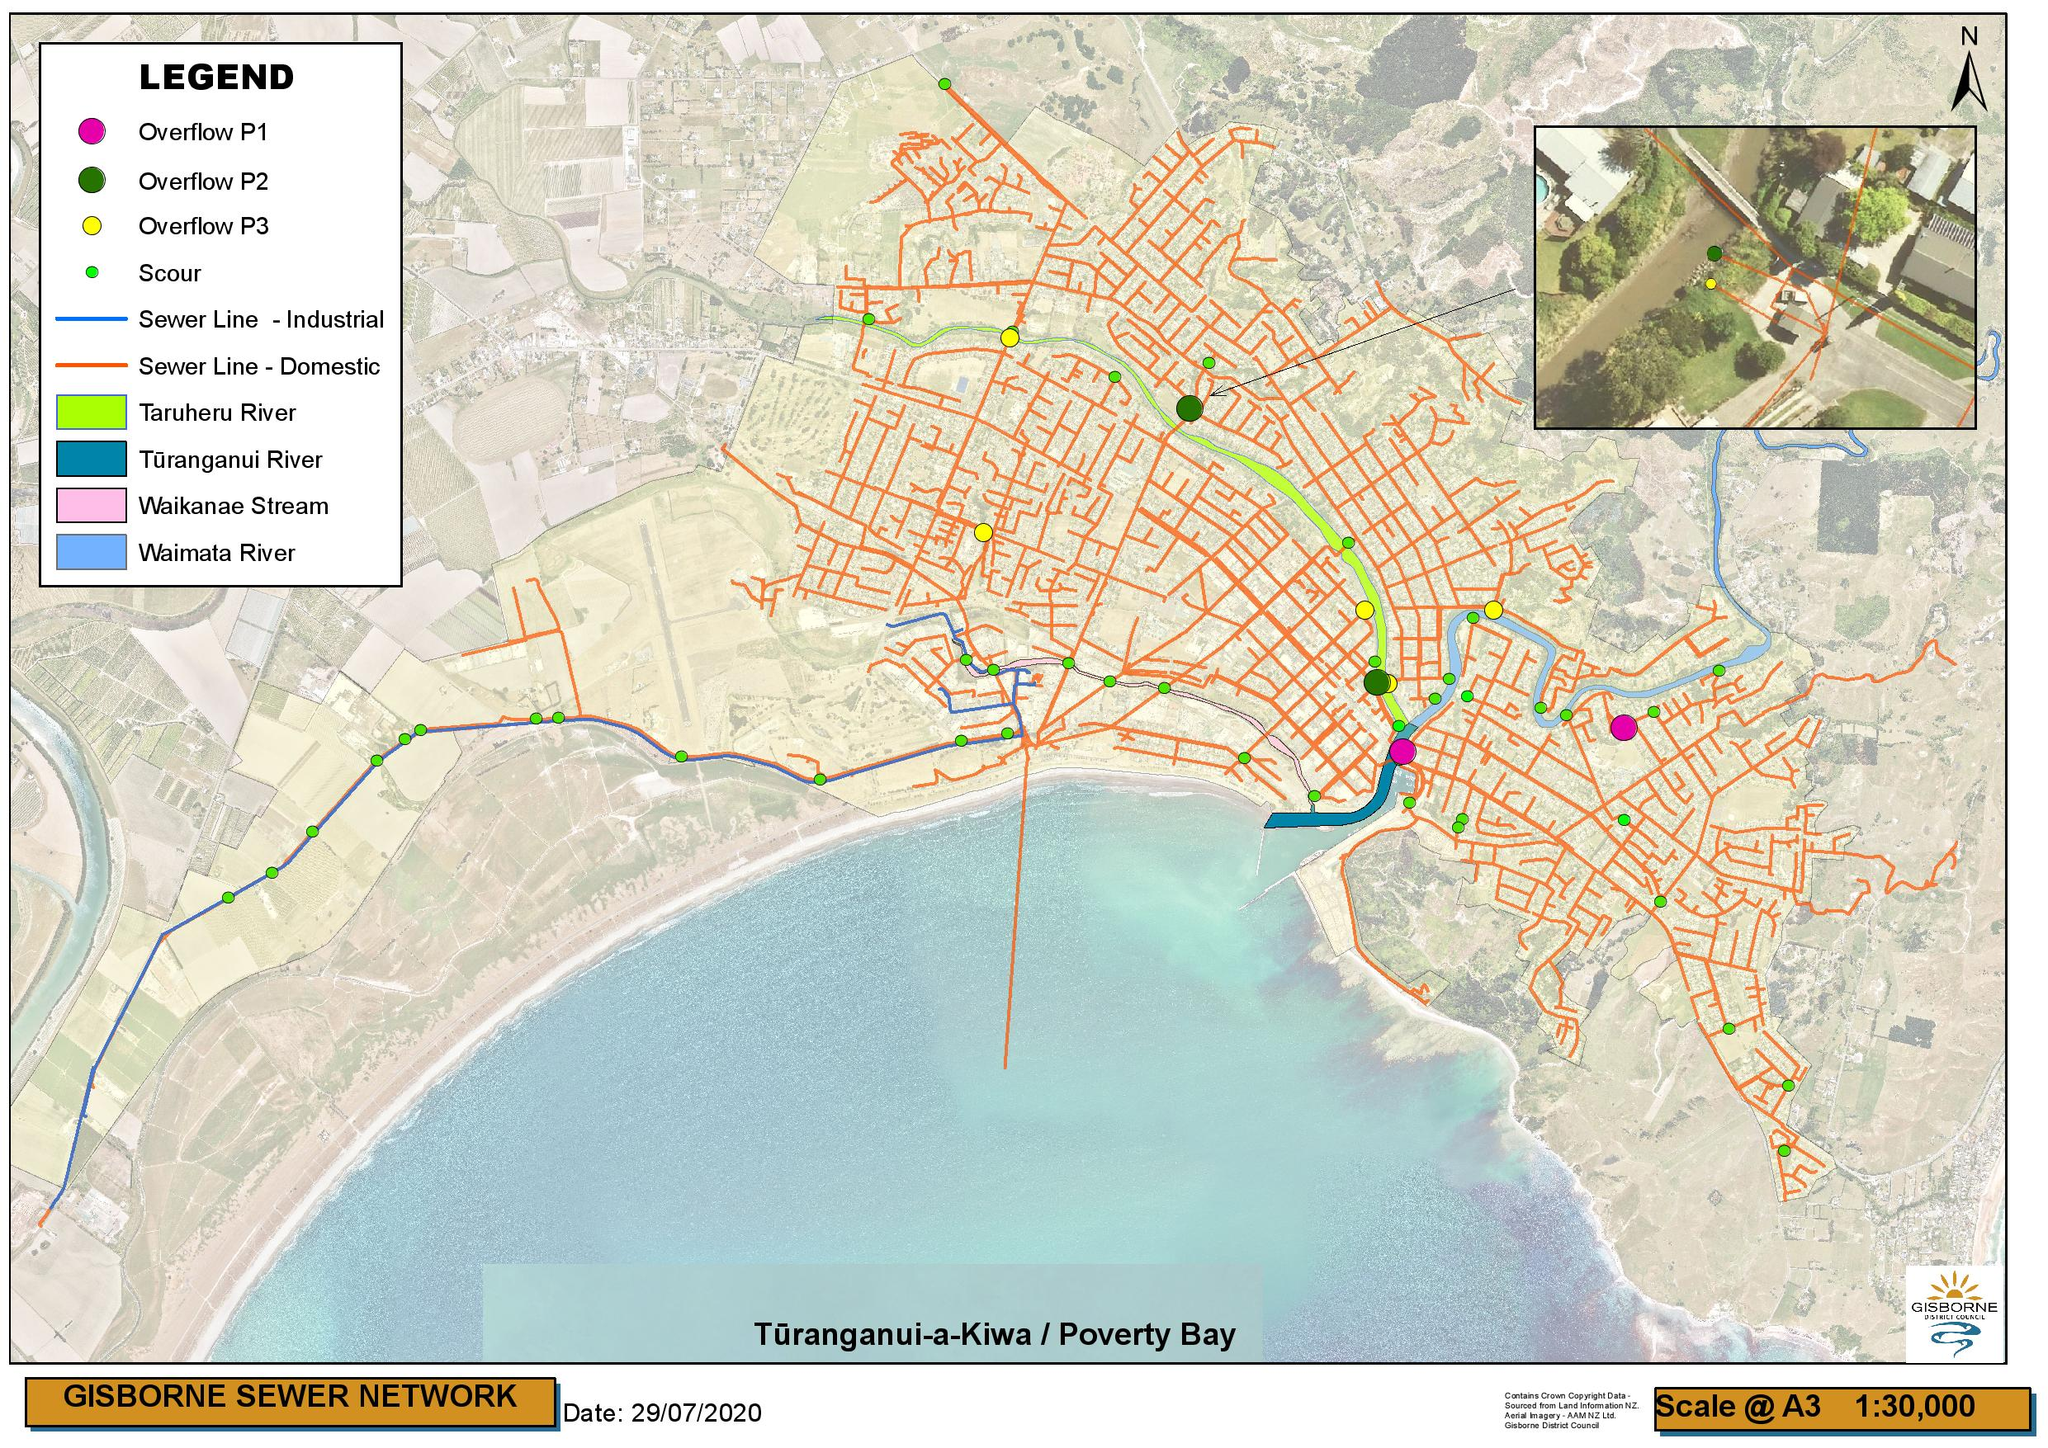

Slide 10
Category | Street Name | Asset Code | Easting | Northing
Primary Overflow Point | Wainui Road | WNUIDO005 | 2037659.42 | 5707953.16
 | Seymour/Turenne | SEYMDO015 | 2039016.11 | 5708096.55
Secondary Overflow Points | Palmerston Road/Peel Street | PALMSO003 | 2037498.91 | 5708376.11
 | Oak Street | OAK_SO074 | 2036347.09 | 5710062.17
Tertiary Overflow Points | Oak Street | OAK_SO080 | 2036346.60 | 5710057.28
 | Lytton Road | LYTTSO045 | 2035240.87 | 5710498.71
 | Childers Road | CHILSO264 | 2035080.77 | 5709303.76
 | Stafford Street | RUSSSO001 | 2038219.38 | 5708824.47
 | Derby Street | DERBSO001 | 2037424.05 | 5708825.96
 | Fitzherbert Street | FITZDO115 | 2037565.64 | 5708371.24

Slide 11


Slide 12
Category | Street Name | Asset Code | Easting | Northing
Primary Overflow Point | Wainui Road | WNUIDO005 | 2037659.42 | 5707953.16
Secondary Overflow Points | Palmerston Road/Peel Street | PALMSO003 | 2037498.91 | 5708376.11
 | Oak Street | OAK_SO074 | 2036347.09 | 5710062.17
Tertiary Overflow Points | Oak Street | OAK_SO080 | 2036346.60 | 5710057.28
 | Lytton Road | LYTTSO045 | 2035240.87 | 5710498.71
 | Childers Road | CHILSO264 | 2035080.77 | 5709303.76
 | Stafford Street | RUSSSO001 | 2038219.38 | 5708824.47
 | Derby Street | DERBSO001 | 2037424.05 | 5708825.96
 | Fitzherbert Street | FITZDO115 | 2037565.64 | 5708371.24
 | Owen Road | OWENSO051 | 2039202.23 | 5708196.09
 | Seymour/Turenne | SEYMDO015 | 2039016.11 | 5708096.55

Slide 13
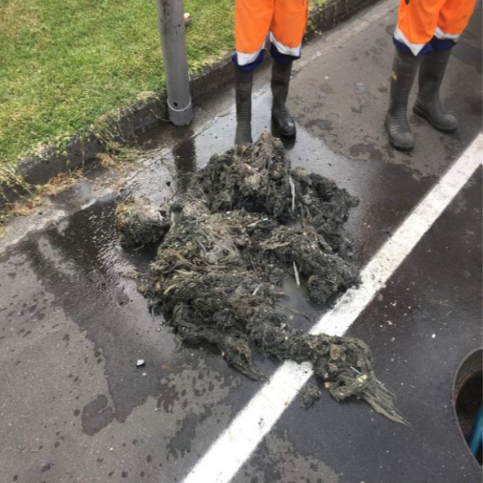
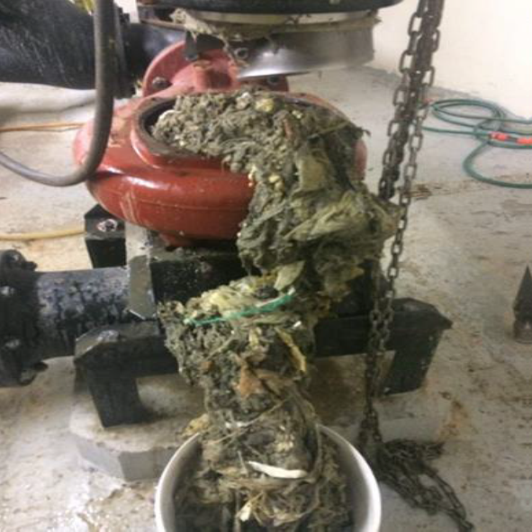
Sewer main in Stanley Road. Mainly composed of rags and wet wipes
Childers Rd Pump Station caught in pump impellors. Rags, clothing, wet wipes, rope and more

Slide 14
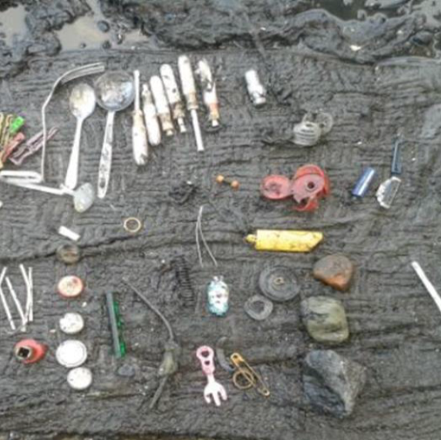
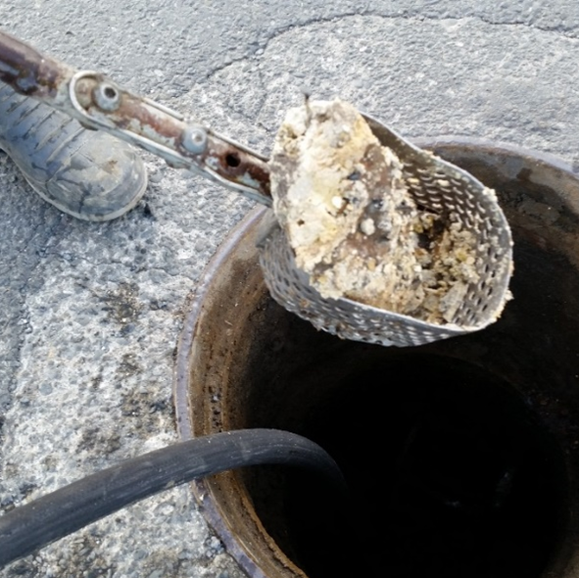
Oak St Interceptor collection items people discard into the sewer
Ballance St. Solidified fat caught on rugs of manhole

Slide 15
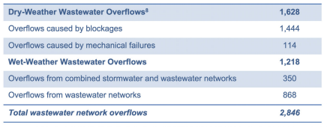

Slide 16
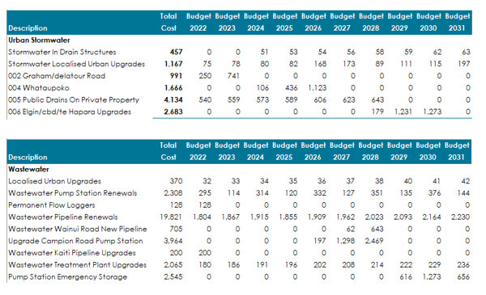

Slide 17
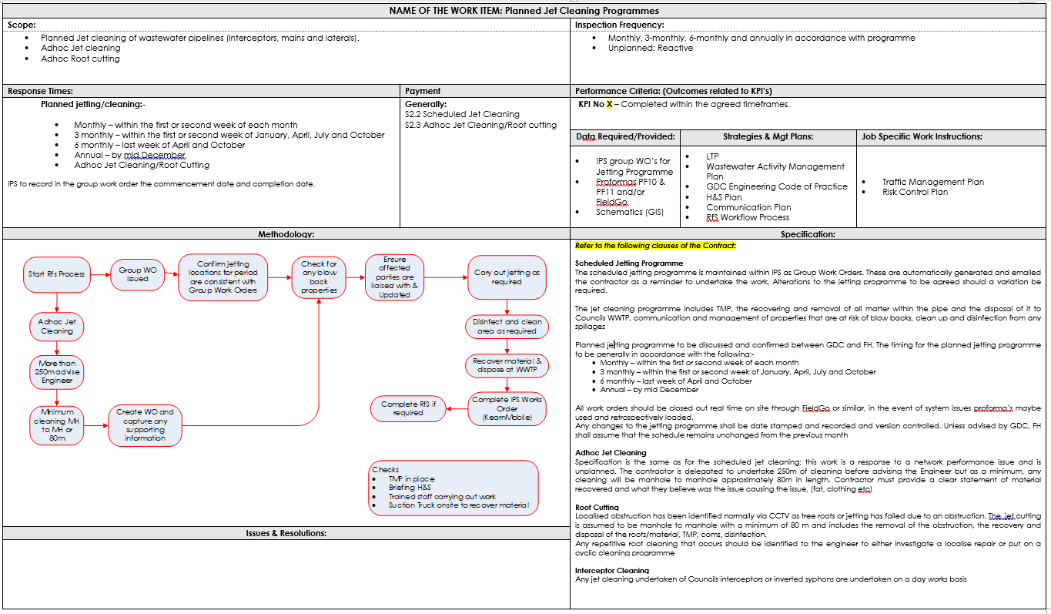

Slide 18
WOLFGANG KANZ

Slide 19
Figure 3 of EIC

Slide 20
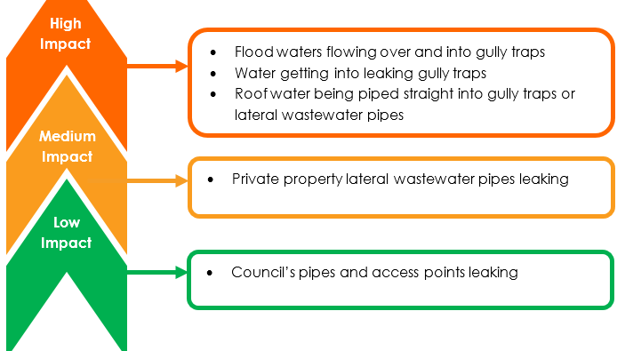
Figure 1 of EIC

Slide 21
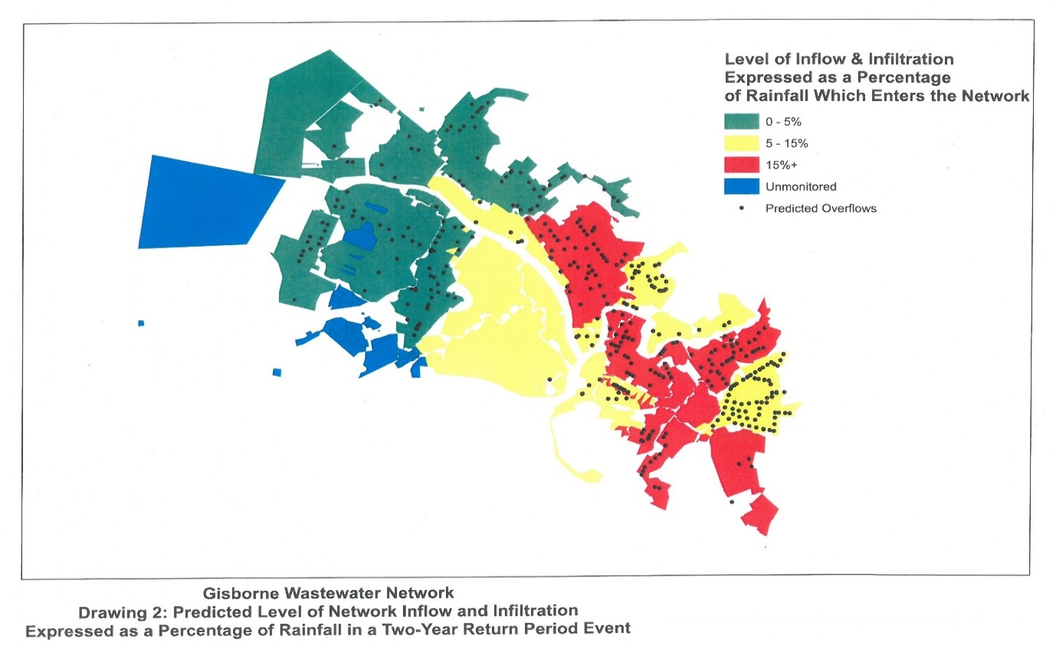
Figure 2 of EIC

Slide 22
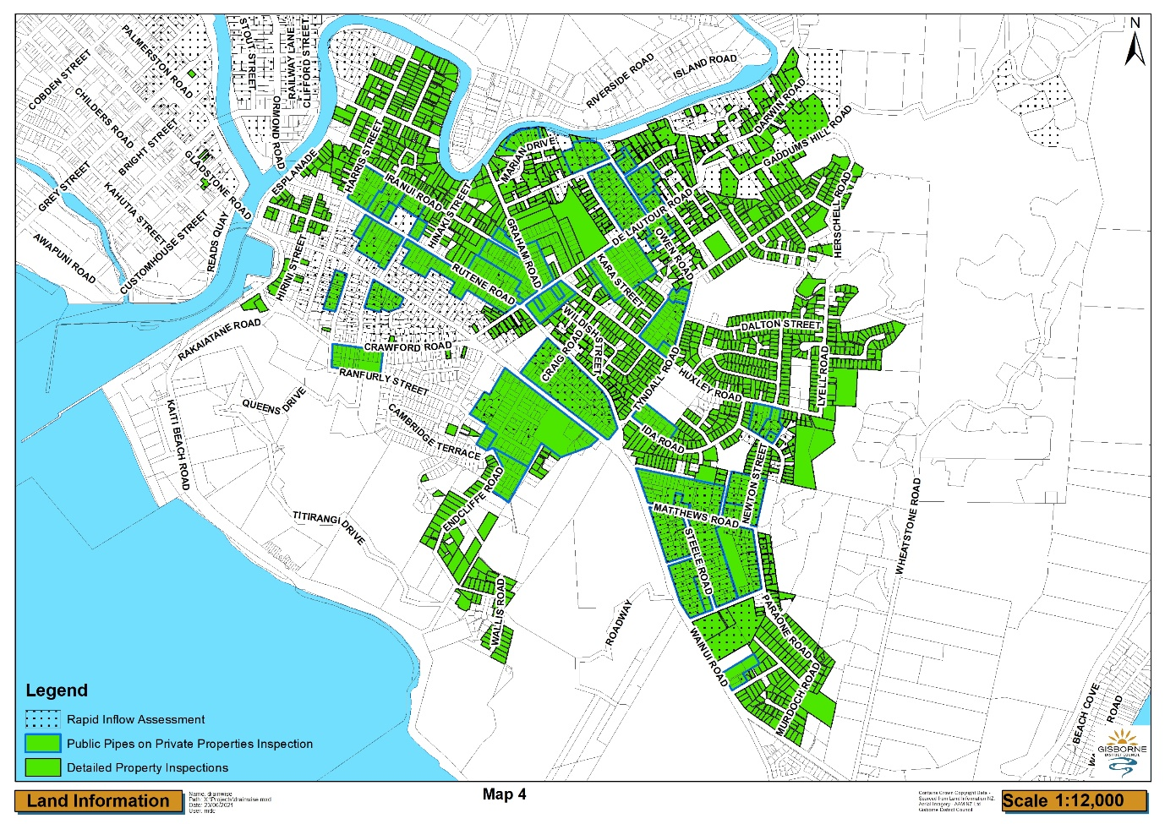
Figure 4 of EIC

Slide 23
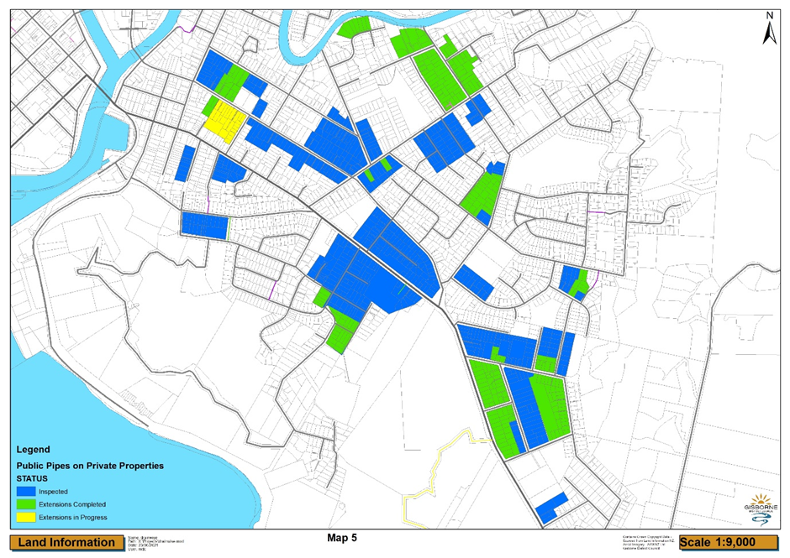
Figure 5 of EIC

Slide 24
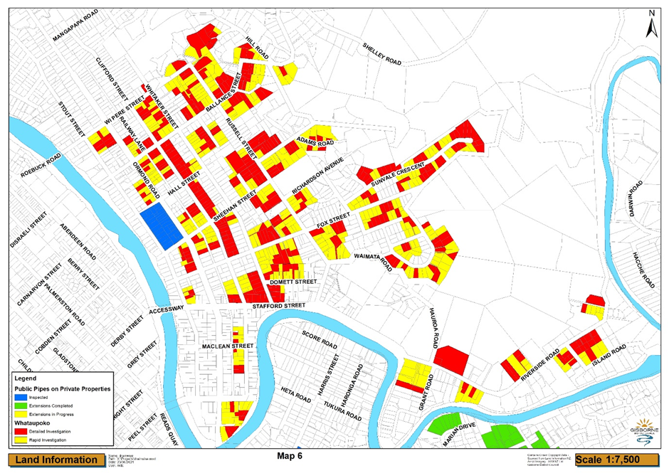
Figure 6 of EIC

Slide 25
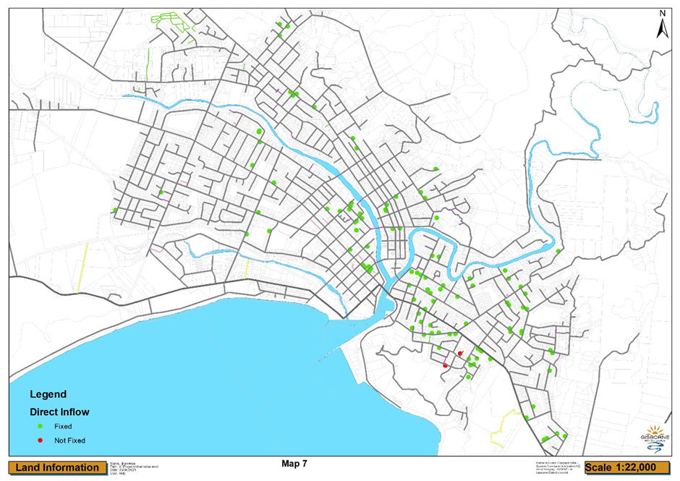
Figure 7 of EIC

Slide 26
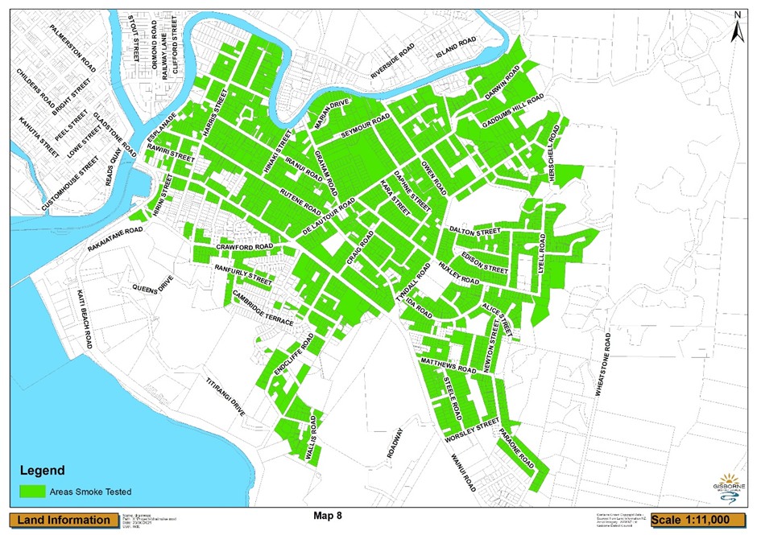
Figure 8 of EIC

Slide 27
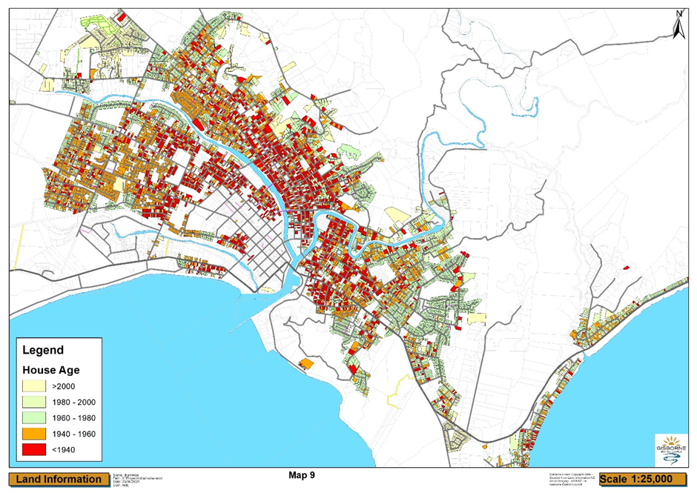
Figure 9 of EIC

Slide 28
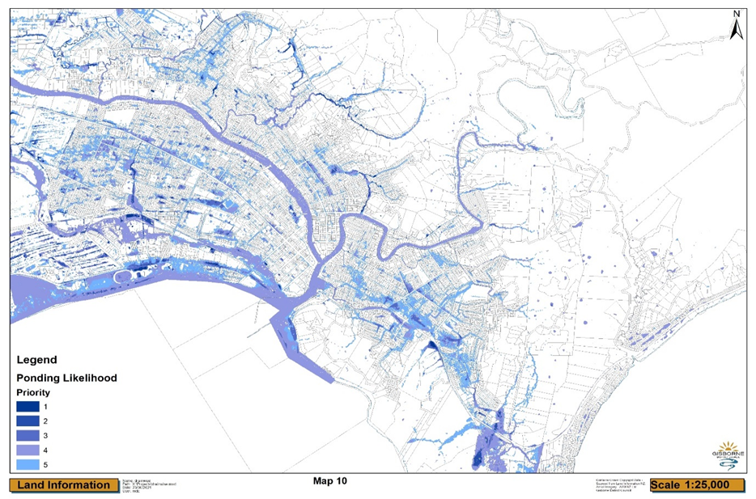
Figure 10 of EIC

Slide 29
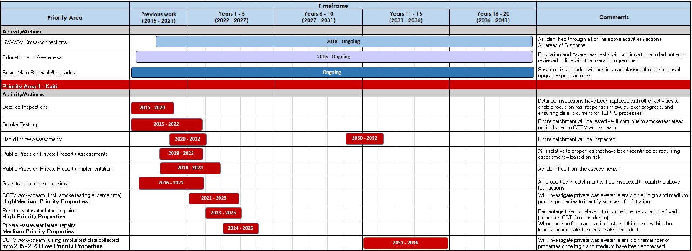
Appendix 1 of EIC

Slide 30
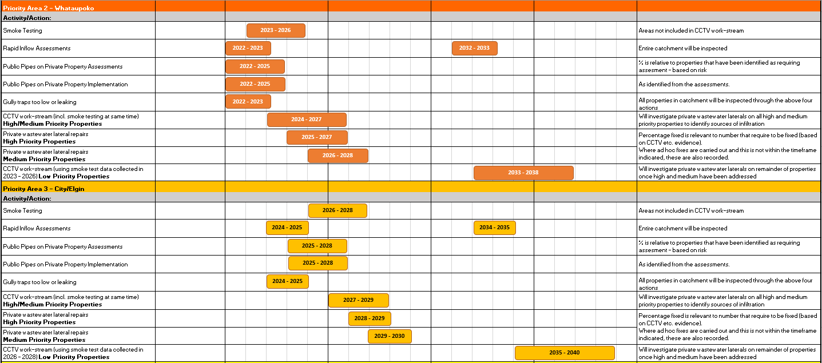
Appendix 1 of EIC

Slide 31
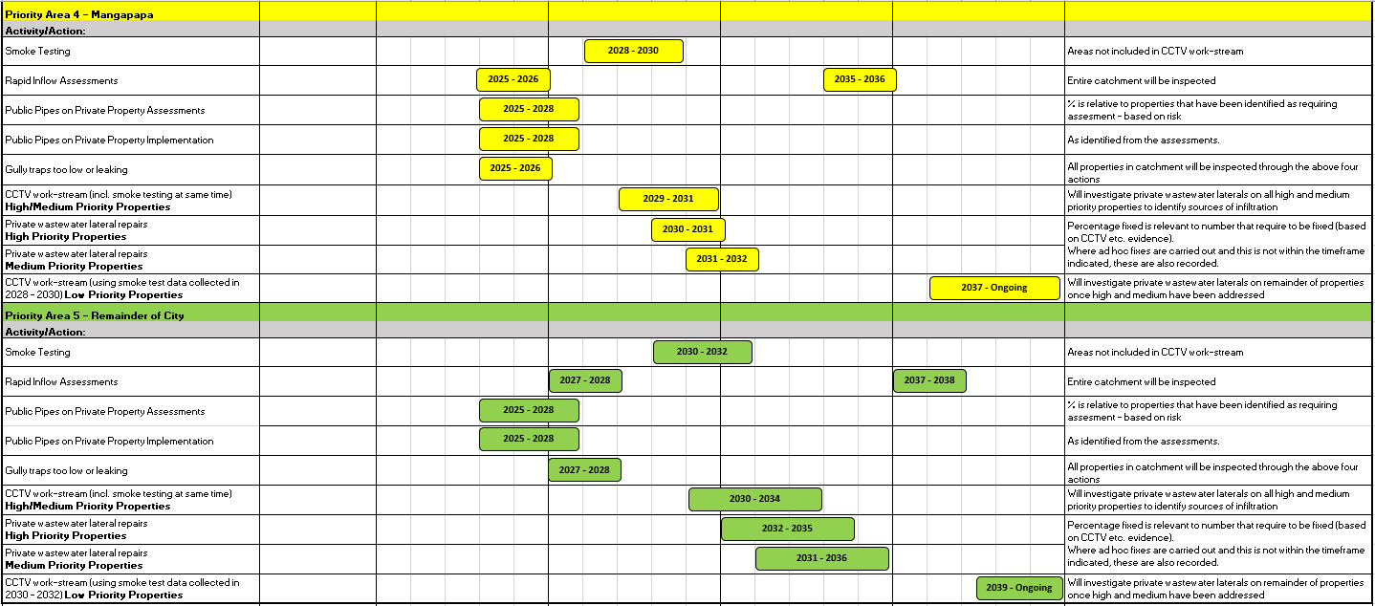
Appendix 1 of EIC

Slide 32
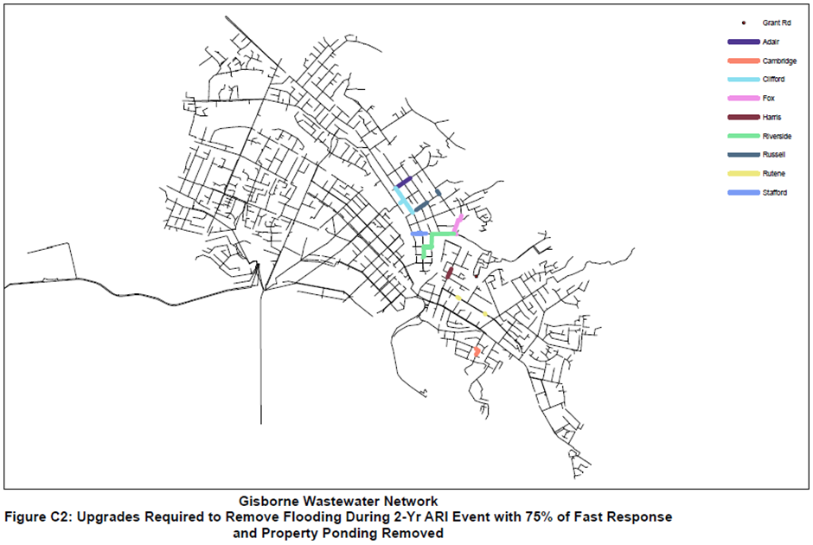
Figure 11a of EIC

Slide 33
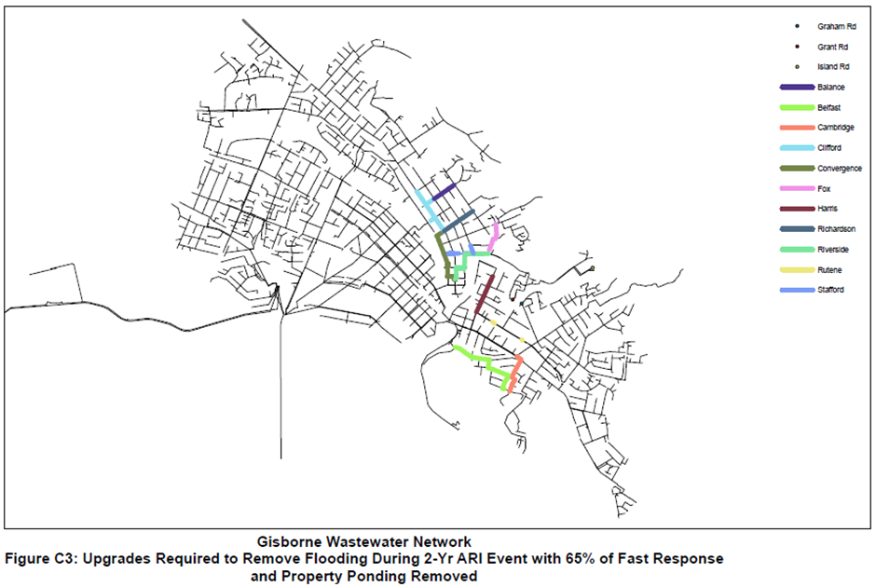
Figure 11b of EIC

Slide 34
IAN GARSIDE

Slide 35
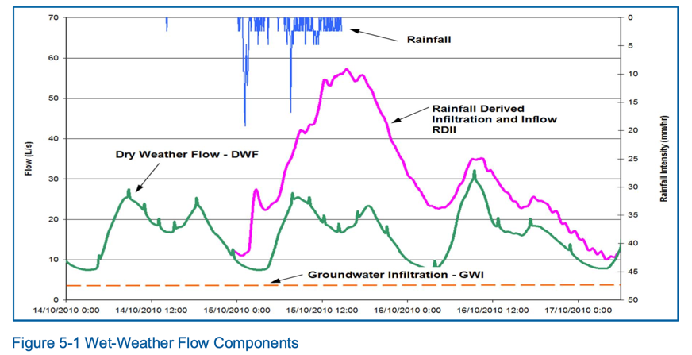

Slide 36
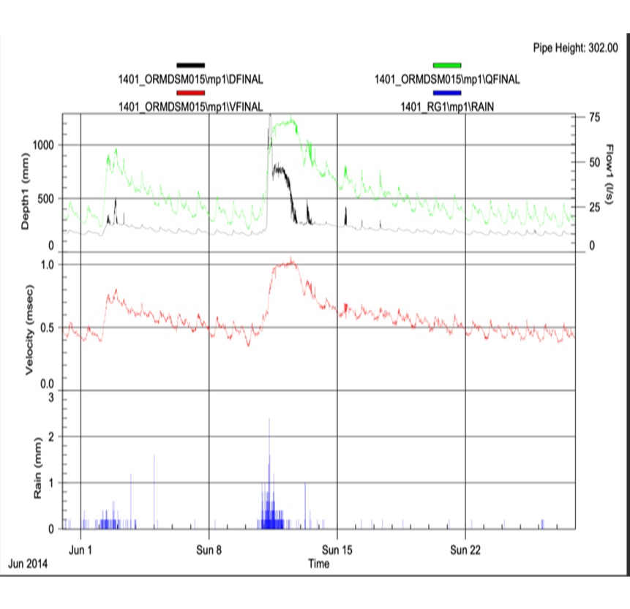

Slide 37
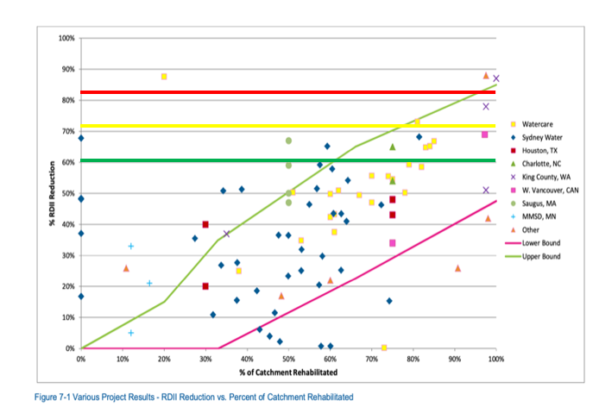

Slide 38
BRIDGET BOSWORTH

Slide 39
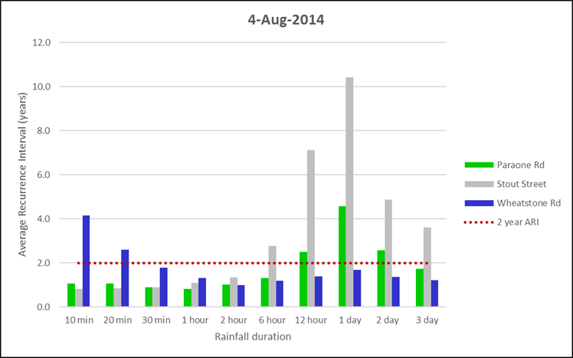

Slide 40
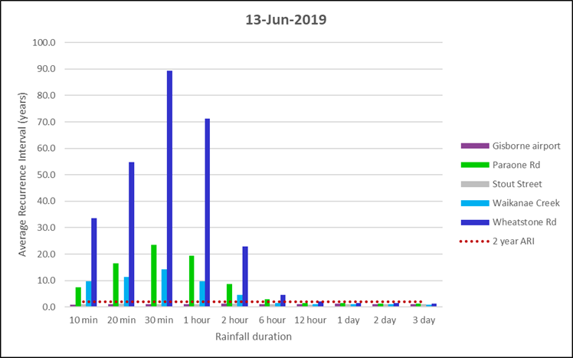

Slide 41
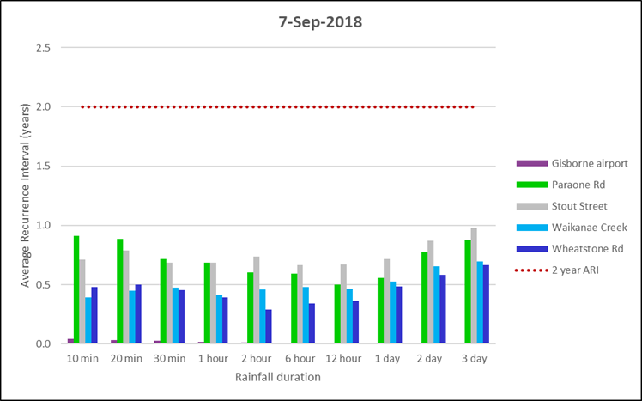

Slide 42
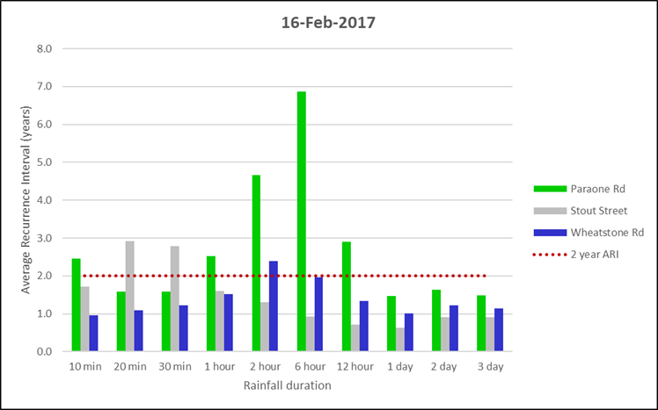

Slide 43
DR BRETT BEAMSLEY

Slide 44
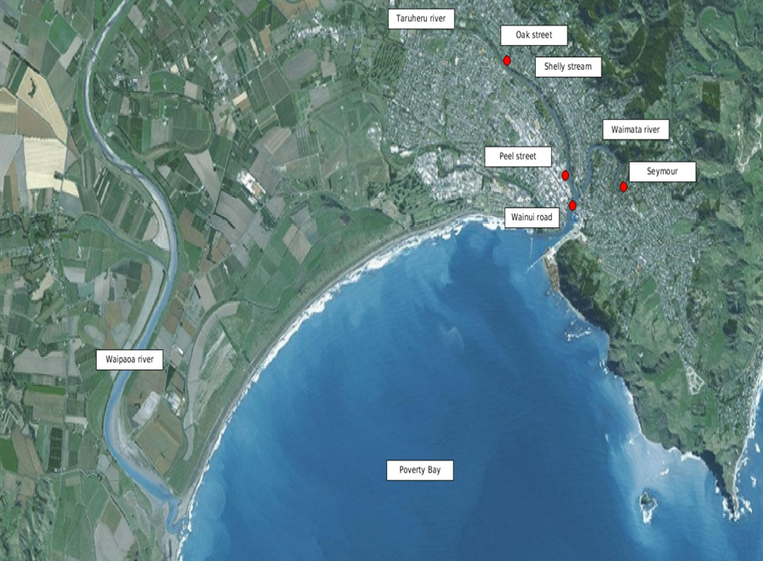

Slide 45
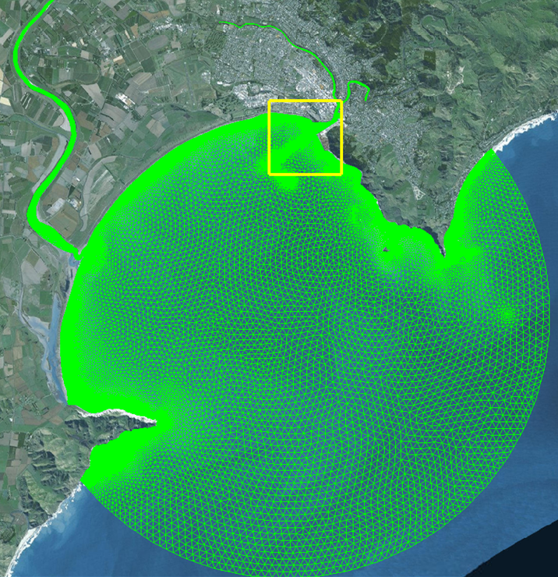

Slide 46
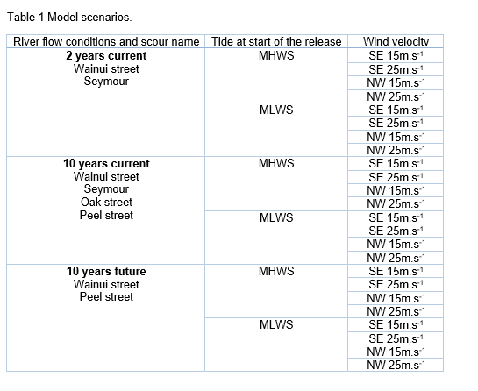

Slide 47
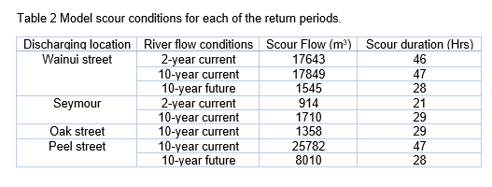

Slide 48
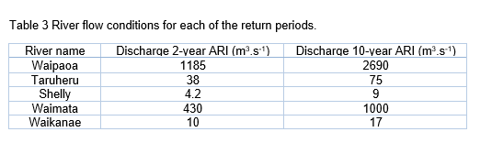

Slide 49
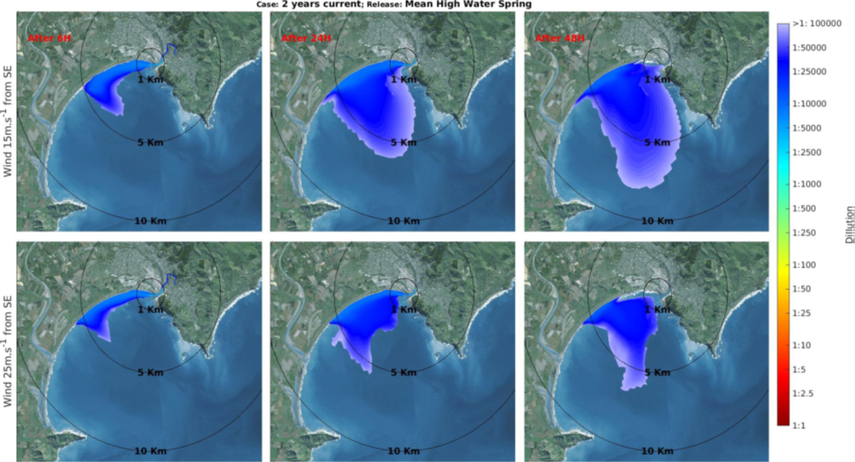

Slide 50
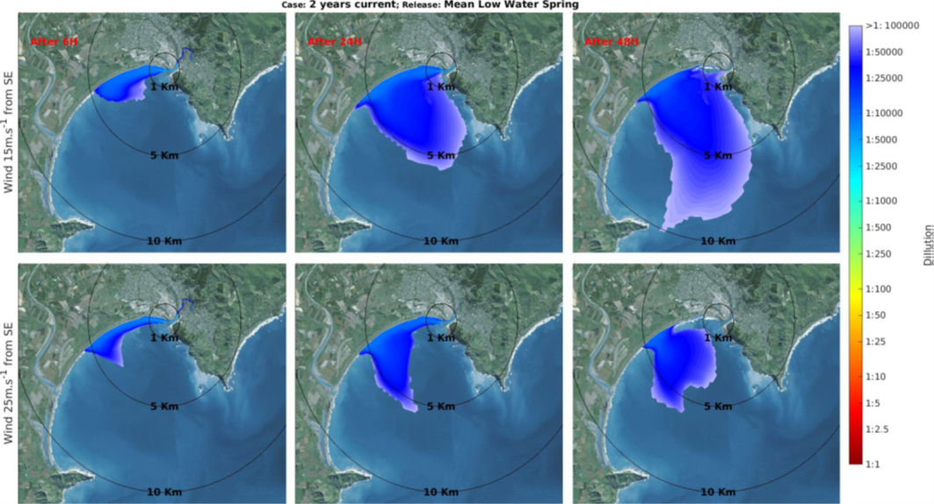

Slide 51
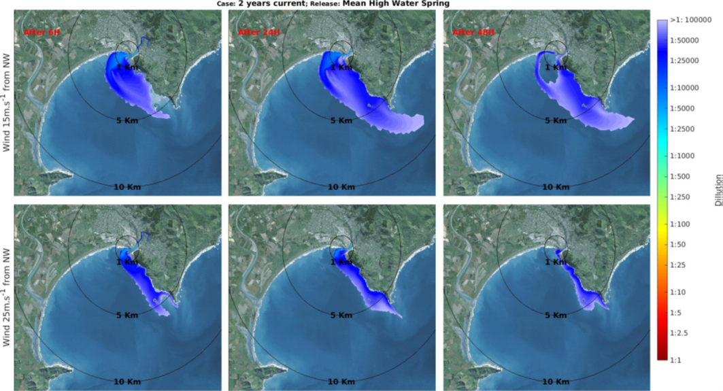

Slide 52
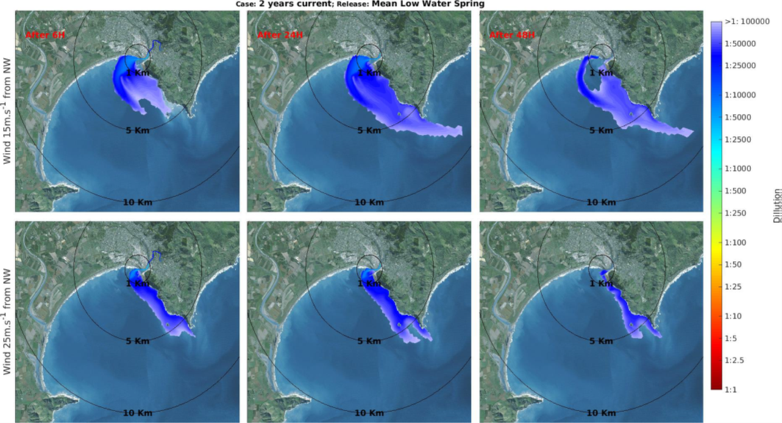

Slide 53
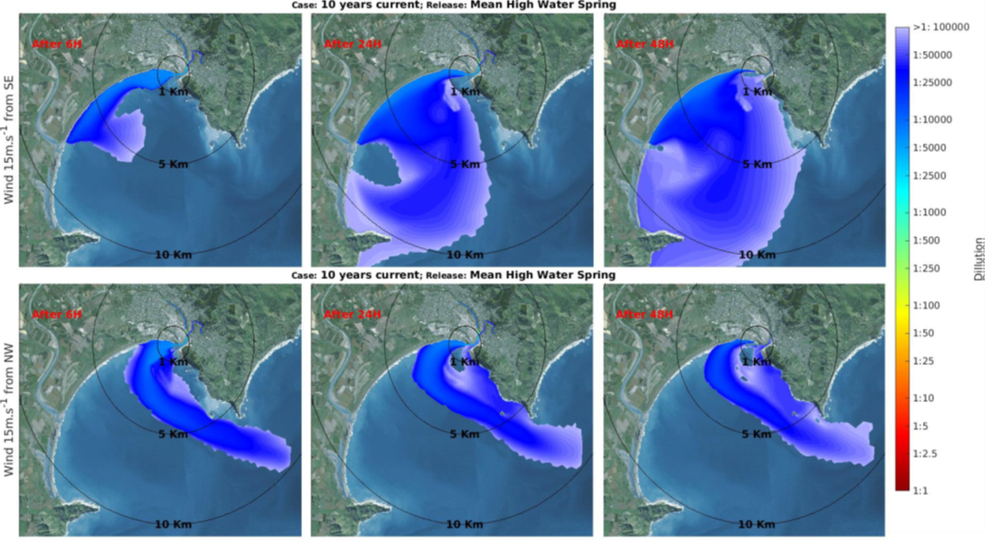

Slide 54
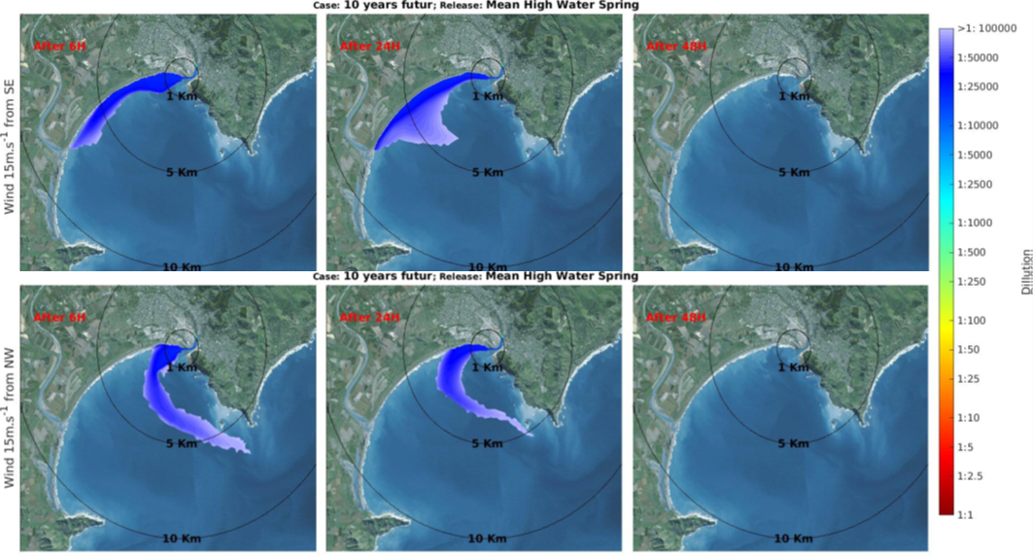

Slide 55
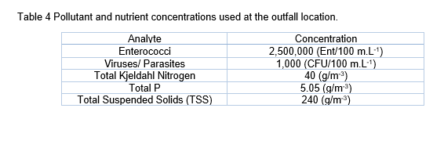

Slide 56
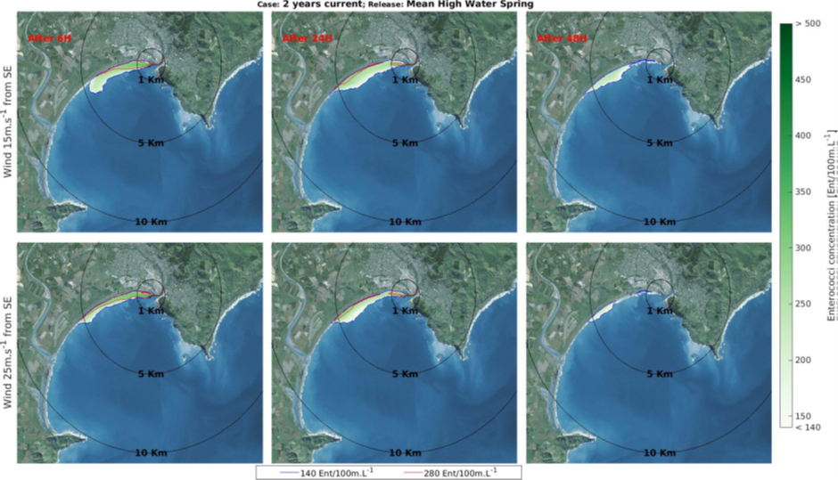

Slide 57
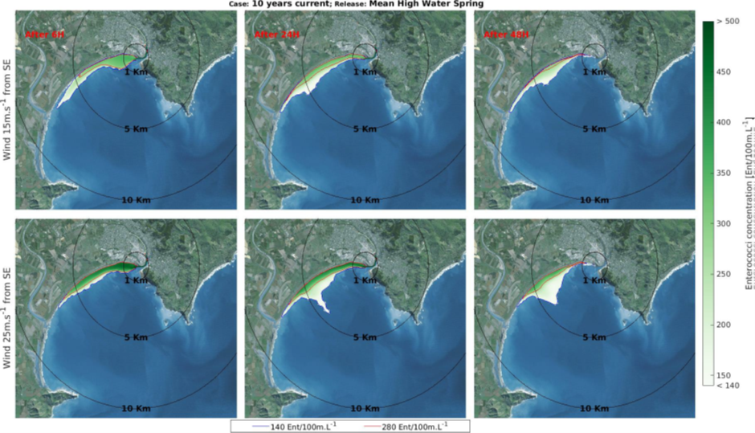

Slide 58
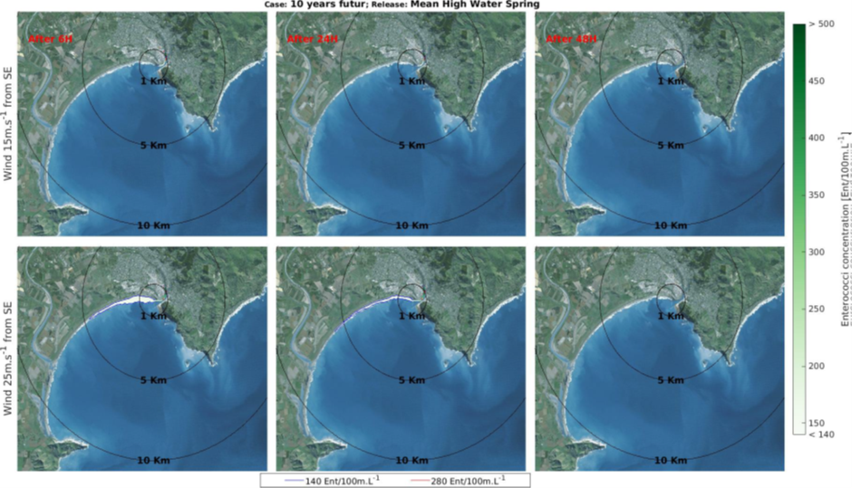

Slide 59
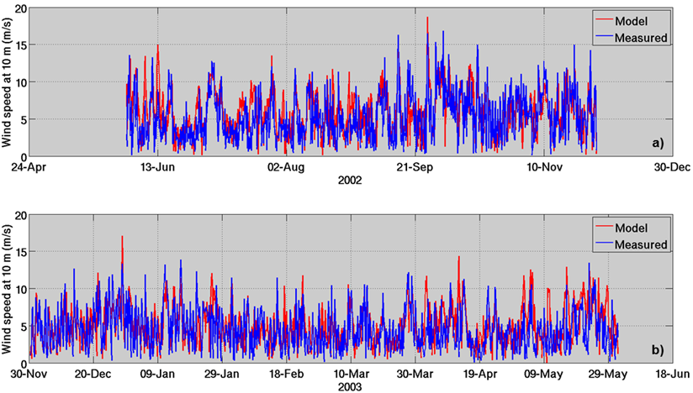

Slide 60
DR SHANE KELLY

Slide 61
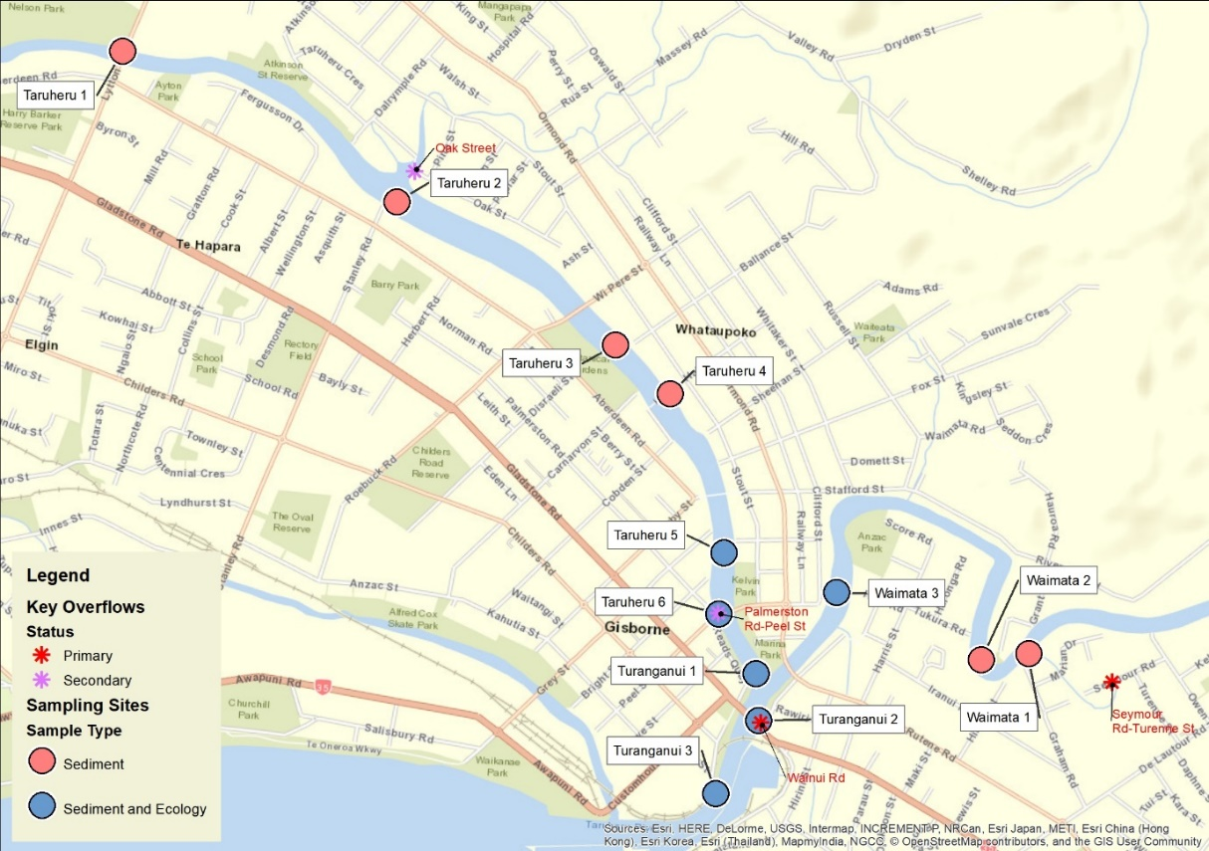

Slide 62
DR PETER WILSON

Slide 63
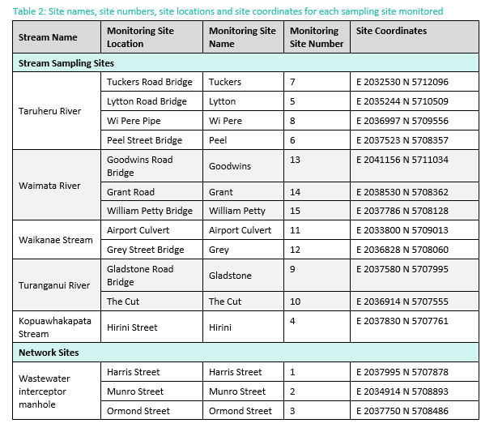

Slide 65


Slide 66


Slide 67

Continued on next page

Slide 68


Slide 69
DR MICHAEL STEWART

Slide 70


Slide 71


Slide 72


Slide 73


Slide 74


Slide 75


Slide 76



Slide 77
DR CHRISTOPHER DADA

Slide 78


Slide 79


Slide 80
APPENDIX 1: MAP OF LOCATIONS AT WHICH HEALTH RISKS WERE MODELLED

Slide 81


Slide 82
IAN MAYHEW

Slide 83
Attachment A1: Overflow locations applicable from the commencement of the consent

Slide 84
Category | Street Name | Asset Code | Easting | Northing
Primary Overflow Point | Wainui Road | WNUIDO005 | 2037659.42 | 5707953.16
 | Seymour/Turenne | SEYMDO015 | 2039016.11 | 5708096.55
Secondary Overflow Points | Palmerston Road/Peel Street | PALMSO003 | 2037498.91 | 5708376.11
 | Oak Street | OAK_SO074 | 2036347.09 | 5710062.17
Tertiary Overflow Points | Oak Street | OAK_SO080 | 2036346.60 | 5710057.28
 | Lytton Road | LYTTSO045 | 2035240.87 | 5710498.71
 | Childers Road | CHILSO264 | 2035080.77 | 5709303.76
 | Stafford Street | RUSSSO001 | 2038219.38 | 5708824.47
 | Derby Street | DERBSO001 | 2037424.05 | 5708825.96
 | Fitzherbert Street | FITZDO115 | 2037565.64 | 5708371.24
^{[1]} NZTM 2000

Slide 85
Attachment A2: Overflow locations applicable in accordance with Condition 20

Slide 86
Category | Street Name | Asset Code | Easting | Northing
Primary Overflow Point | Wainui Road | WNUIDO005 | 2037659.42 | 5707953.16
Secondary Overflow Points | Palmerston Road/Peel Street | PALMSO003 | 2037498.91 | 5708376.11
 | Oak Street | OAK_SO074 | 2036347.09 | 5710062.17
Tertiary Overflow Points | Oak Street | OAK_SO080 | 2036346.60 | 5710057.28
 | Lytton Road | LYTTSO045 | 2035240.87 | 5710498.71
 | Childers Road | CHILSO264 | 2035080.77 | 5709303.76
 | Stafford Street | RUSSSO001 | 2038219.38 | 5708824.47
 | Derby Street | DERBSO001 | 2037424.05 | 5708825.96
 | Fitzherbert Street | FITZDO115 | 2037565.64 | 5708371.24
 | Owen Road | OWENSO051 | 2039202.23 | 5708196.09
 | Seymour/Turenne | SEYMDO015 | 2039016.11 | 5708096.55
^{[1]} NZTM 2000

Slide 87
Attachment B: Wastewater Overflow Consent Objectives and Targets
Issue | Objective | Measure/Target | Target Timeframe | Reporting (annual based on financial year)
Wet Weather Overflow Frequency Level of Service | Progressively reduce frequency of overflow events | Progressive reduction in frequency (indicative) | On-going – indicative until target below16F | Number of overflow events Duration of each overflow event Results of monitoring Return period rainfall assessment for each overflow event
 |  | No overflows in events up to and including 50% AEP rainfall event | 10 years after commencement of consent
Wet Weather Overflow Volume | Progressively reduce volume of overflow events for a similar size rainfall event. | Progressive reduction in volume for same AEP rainfall event (indicative) | On-going – indicative17F | Volume of each overflow event Return period rainfall assessment for each overflow event Total volume of overflow per year
Overflows opened in a wet weather event | Limit overflows to primary and secondary overflow points in all but very large rainfall events | Primary only – up to 50% AEP event Secondary – only opened in events larger than 50% AEP Tertiary – only in events > 10% AEP | 5 years after commencement of consent | Overflow locations opened Return period rainfall assessment for each overflow event
 |  | Primary and secondary – only in events larger than 50% AEP Tertiary – only in events > 10% AEP | 10 years after commencement of consent
Dry Weather Overflow frequency | Minimise dry weather overflows to the extent practicable | ≤1 dry weather overflow per 1,000 connections (no more than 15 in total) per year | Upon commencement of consent | Number and location of DWO per year Cause of overflow Whether overflow reached a waterway and which one Measures undertaken to mitigate effects, including response time Results of monitoring Estimated discharge volume
^{[1]} Indicative because change will take some time to become fully evident
^{[2]} Indicative because relationships between AEP and volumes are complex and require further assessment

Slide 88
Attachment C: LTP Levels of Service and Performance Measures (for monitoring and reporting)
(from LTP 2018-2028 p4-40 and 4-41 – updated to reflect current (2018/19 performance)
Level of Service | Performance Measures | Current (18/19) | Target
 |  |  | Years 1-3 | Years 4-10
We provide a well-managed wastewater reticulation and treatment system which protects public health and the physical environment. | System and Adequacy: The number of dry weather sewage overflows from the territorial authority’s sewerage system, expressed per 1000 sewerage connections to that sewerage system (Department of Internal Affairs)15F. | 0.27 | 1 | 0.6
 | Management of environmental impacts: Compliance with resource consents for discharge from the wastewater system: Measured by the number of: a) abatement notices; b) infringement notices; c) enforcement orders; and d) convictions (Department of Internal Affairs). | 0 | 0 | 0
 | Response to wastewater system faults attendance at wastewater overflows resulting from a blockage or other fault in wastewater system: a) Median attendance time: from the notification of the fault to the time that service personnel reach the site (hours). | 0.28 | 1 | 0.5
 | b) Median resolution measured from the notification of the fault to the time that service personnel confirm resolution (hours) (Department of Internal Affairs). | 3.25 | 12 | 6
 | Customer Satisfaction: Complaints about odour; system faults; blockages; AND Council’s response to issues with its wastewater system: The total number of complaints per 1000 connections received (Department of Internal Affairs). | 10.03 | 15 | 13
 | Percentage of residents satisfied with the Gisborne district’s wastewater system as found in the Resident Satisfaction Survey. | 55% | 50% | 60%
 | The annual number of events where sewerage is discharged from Council’s reticulation into rivers or streams (in a less than a 1 in 10-year rain event). | 2 | ≤4 | ≤4
^{[1]} Territorial Authority mandatory measure

Slide 89
Table 4: Wet Weather Overflow Performance 2009 to 2018
Year9F | Number of Events | Date | Number of Overflow Points Activated | Maximum Duration of Overflow (hours)10F | Estimated Volume (m³)
2006/07 | 3 | 6 July 2006 | 1 | 2.17 | Not Available
 |  | 18 July 2004 | 1 | 15.83
 |  | 10 September 2006 | 2 | 11.75
2007/08 | 1 | 19 June 2008 | 1 | 7 | Not Available
2008/09 | 1 | 29 June 2009 | 7 | 75.50 | Not Available
2009/10 | 2 | 18 July 2009 | 2 | 9 | Not Available
 |  | 28 May 2010 | 2 | 20 | Not Available
2010/11 | 3 | 13 October 2010 | 2 | 19 | Not Available
 |  | 22 March 2011 | 5 | 22 | Not Available
 |  | 26 April 2011 | 4 | 26 | 29,937
2011/12 | 4 | 5 July 2011 | 4 | 32 | 32,922
 |  | 23 July 2011 | 2 | 22 | 16,630
 |  | 20 March 2012 | 9 | 38 | 46,080
 |  | 4 April 2012 | 10 | 78 | 72,288
2012/13 | 3 | 24 July 2012 | 3 | 93 | 44,210
 |  | Unknown | 1 | 12 | Not Available
 |  | 13 November 2013 | 4 | 13 | 14,858
2013/14 | 4 | 13 July 2013 | 4 | 49 | 35,551
 |  | 11 August 2013 | 4 | 25 | 24,823
 |  | 18 April 2014 | 7 | 25 | 35,232
 |  | 11 June 2014 | 12 | 47 | 65,222
2014/15 | 1 | 4 August 2014 | 11 | 44 | 48,159
2015/16 | 1 | 20 September 2015 | 8 | 37 | 42,081
2016/17 | 4 | 4 April 2017 | 8 | 18 | 27,253
 |  | 13 April 2017 | 5 | 12 | 10,501
 |  | 12 May 2017 | 3 | 11 | 9,915
 |  | 29 May 2017 | 2 | 14 | 7,127
2017/18 | 3 | 3 September 2017 | 1 | 22 | 8,931
 |  | 4 June 2018 | 2 | 26 | 11,279
 |  | 11 June 2018 | 6 | 48 | 36,956
2018/19 | 3 | 6 August 2018 | 1 | 24 | 9,680
 |  | 7 September 2018 | 1 | 43 | 10,087
 |  | 13 June 2019 | 2 | 13 | 6,020
2019/20 | 1 | 15 October 2019 | 1 | 29.5 | 9,796
^{[1]} In accordance with asset reporting requirements, and consistent with national practice, overflows are reported over a financial year 1 July to 30 June
^{[2]} The longest time that a single overflow point was open for during an overflow event

Slide 90


Figure 7: Overflow Number and Volume by Year (2011 to 2019 FY)

